Slide 1
Data Presentation
Marketing Analytics Project

Slide 2
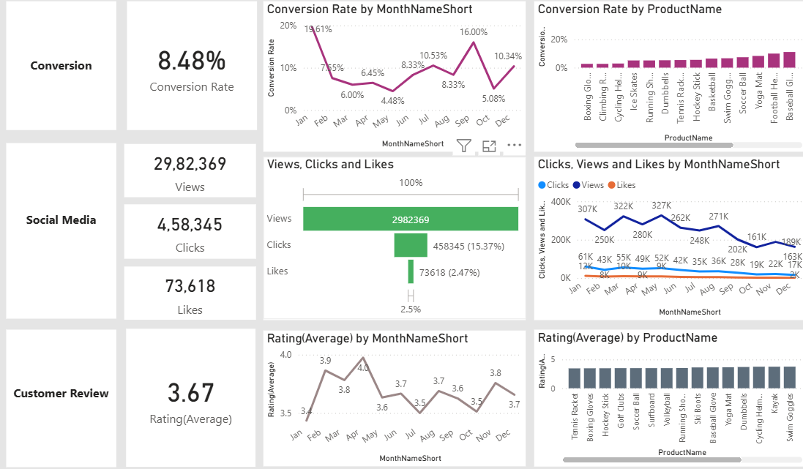
Overview
Decreased Conversion Rates: The conversion rate demonstrated a strong rebound in December, reaching 10.34%, despite a notable dip to 5.08% in October.
Reduced Customer Engagement:
  There is a decline in overall social media engagement, with views dropping throughout the year.
  While clicks and likes are low compared to views, the click-through rate stands at 15.37%, meaning that engaged users are still interacting effectively.
Customer Feedback Analysis:
  Customer ratings have remained consistent, averaging around 3.7 throughout the year.
  Although stable, the average rating is below the target of 4.0, suggesting a need for focused improvements in customer satisfaction, for products below 3.5.

Slide 3
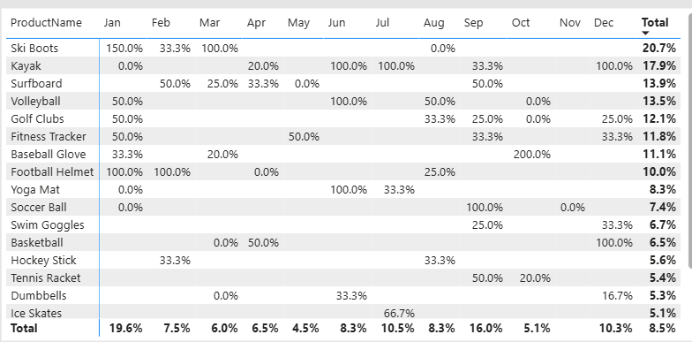
Decreased Conversion Rates
General Conversion Trend:
  Throughout the year, conversion rates varied, with higher numbers of products converting successfully in months like July and September. This suggests that while some products had strong seasonal peaks, there is potential to improve conversions in lower-performing months through targeted interventions.
Lowest Conversion Month:
  May experienced the lowest overall conversion rate at 4.5%, with no products standing out significantly in terms of conversion. This indicates a potential need to revisit marketing strategies or promotions during this period to boost performance.
Highest Conversion Rates:
  January recorded the highest overall conversion rate at 19.6%, driven significantly by the Ski Boots with a remarkable 150% conversion. This indicates a strong start to the year, likely fueled by seasonal demand and effective marketing strategies.

Slide 4
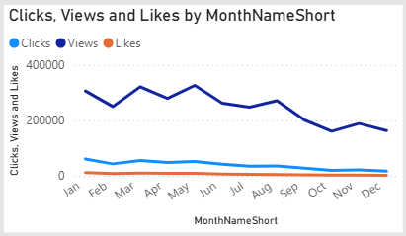
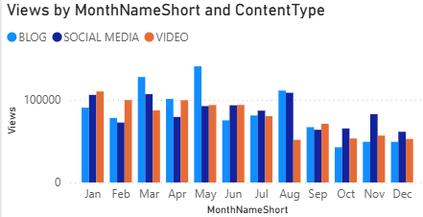
Reduced Customer Engagement
Declining Views:
  Views peaked in February and May but declined from August and on, indicating reduced audience engagement in the later half of the year.
Low Interaction Rates:
  Clicks and likes remained consistently low compared to views, suggesting the need for more engaging content or stronger calls to action.
Content Type Performance:
  Blog content drove the most views, especially in March and May, while social media and video content maintained steady but slightly lower engagement.

Slide 5
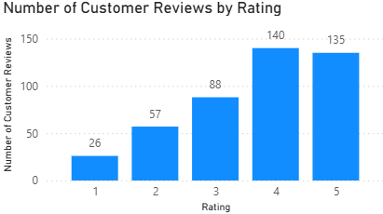
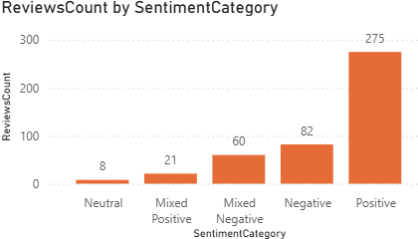
Customer Feedback Analysis
Customer Ratings Distribution:
  The majority of customer reviews are in the higher ratings, with 140 reviews at 4 stars and 135 reviews at 5 stars, indicating overall positive feedback. Lower ratings (1-2 stars) account for a smaller proportion, with 26 reviews at 1 star and 57 reviews at 2 stars.
Sentiment Analysis:
  Positive sentiment dominates with 275 reviews, reflecting a generally satisfied customer base. Negative sentiment is present in 82 reviews, with a smaller number of mixed and neutral sentiments, suggesting some areas for improvement but overall strong customer approval.
Opportunity for Improvement:
  The presence of mixed positive and mixed negative sentiments suggests that there are opportunities to convert those mixed experiences into more clearly positive ones, potentially boosting overall ratings. Addressing the specific concerns in mixed reviews could elevate customer satisfaction.

Slide 6
Goals AND Actions
Goals
1.Increase Conversion Rates:
  Goal: Identify factors impacting the conversion rate and provide recommendations to improve it.
  Insight: Highlight key stages where visitors drop off and suggest improvements to optimize the conversion funnel.
2.Enhance Customer Engagement:
  Goal: Determine which types of content drive the highest engagement.
  Insight: Analyze interaction levels with different types of marketing content to inform better content strategies.
3.Improve Customer Feedback Scores:
  Goal: Understand common themes in customer reviews and provide actionable insights.
  Insight: Identify recurring positive and negative feedback to guide product and service improvements.
Actions
1.Increase Conversion Rates:
  Marketing initiatives should prioritize high-performing product categories, specifically Ski Boots, Kayaks, and Volleyball, which have demonstrated consistently elevated conversion rates. To optimize outcomes, seasonal peaks should be strategically leveraged by implementing targeted promotions and personalized campaigns during high-conversion months such as January, March, and September.
2.Enhance Customer Engagement:
  Revitalize the content strategy to address declining views and reduced interaction rates by incorporating more engaging formats, such as interactive videos and user-generated content. Furthermore, enhance audience engagement by strategically optimizing call-to-action placements across social media and blog channels, with particular emphasis during historically lower-engagement periods from September through December.
3. Improve Customer Feedback Scores:
  Improve Customer Feedback Scores by systematically addressing mixed and negative reviews through the implementation of a structured feedback loop. This process should involve analyzing recurring issues, developing targeted improvement plans, and actively engaging with dissatisfied customers to resolve concerns. Follow-up initiatives may further encourage re-rating, thereby supporting progress toward achieving the target average rating of 4.0.

